Slide 1
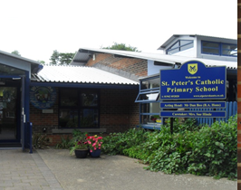

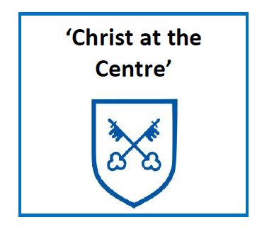
Welcome to the information evening
2026

Slide 2
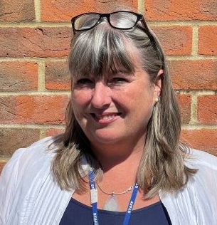
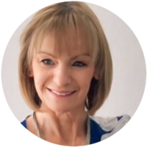
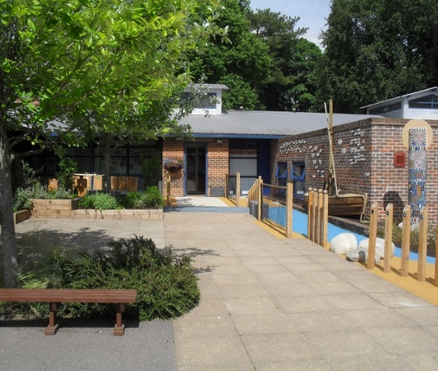
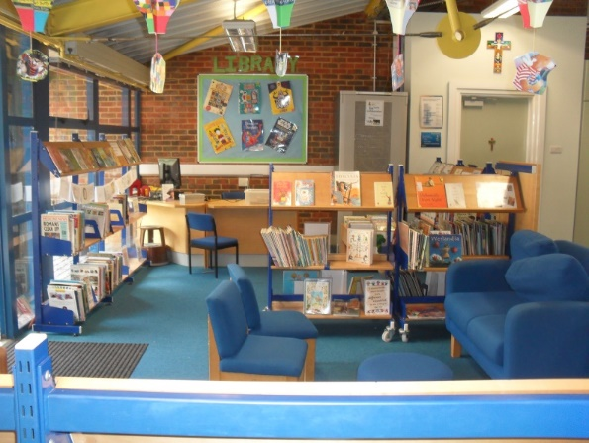
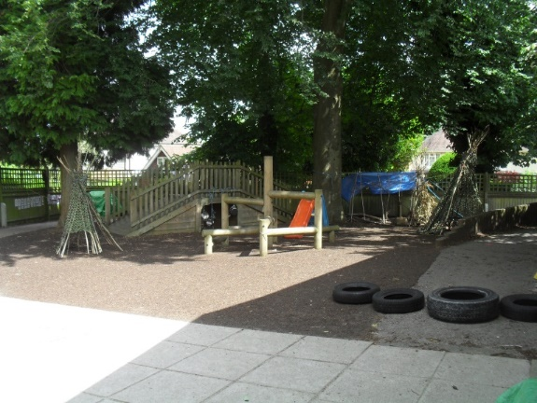
Welcome to the St Peter’s Family.

Slide 3
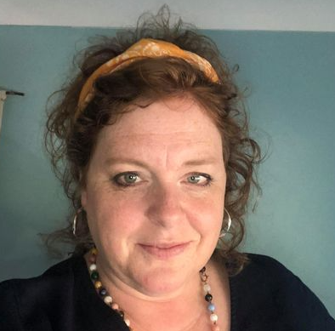
SENDCO
Mrs. G Foster

Slide 4
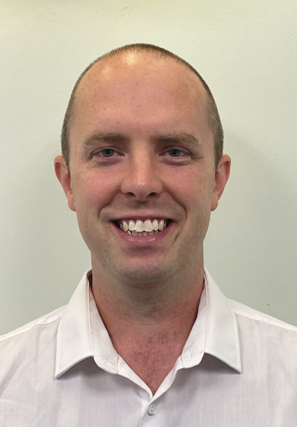


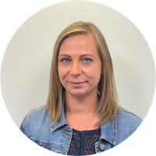
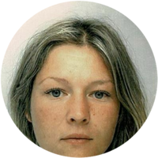

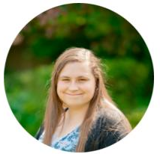
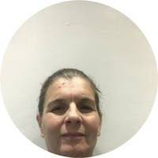
Meet the Early Years Team
Mr Read EYFS and KS1 Lead
Mr Hughes
Mrs Bradbury
Miss Compton Mrs Woods Mrs Solivajs Mrs M Mrs Athill

Slide 5
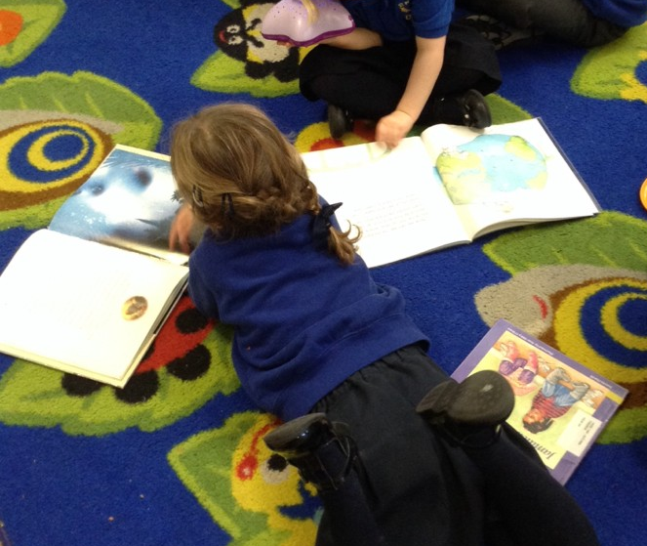
Wednesday
Dates for your Diaries
May, June and July
Visits and phone calls to pre-schools and nursery settings.
Drop in sessions Thursday 18th June, Wednesday 24th June and Wednesday 1st July at 3:45-4:15pm
‘Stay and Play’ Friday 17th July 9:15-10:15am
September
Year R start full time on Monday 7th September
Home visits between Wednesday 2nd to Friday 4th September

Slide 6
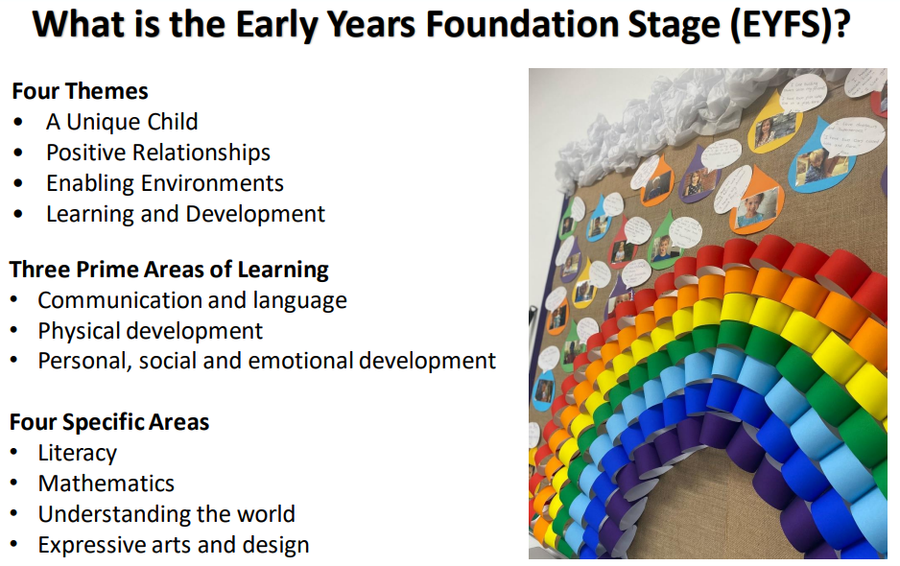

Slide 7
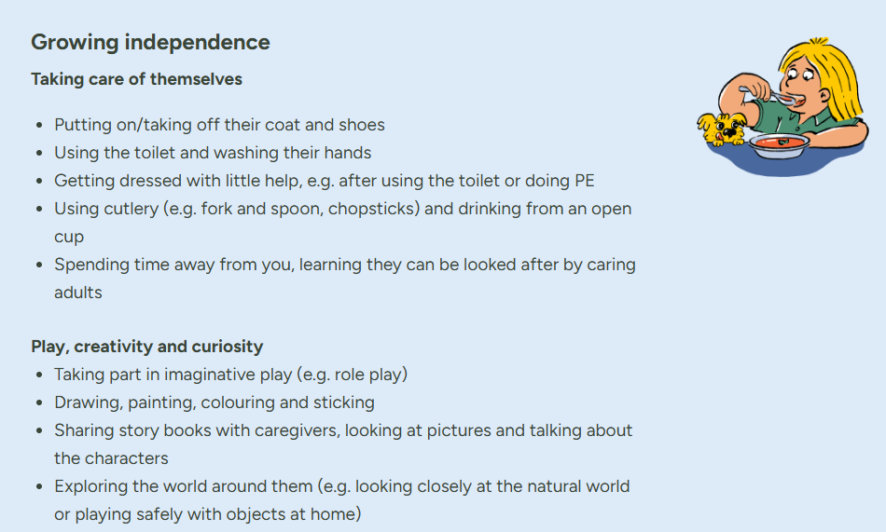
School readiness

Slide 8
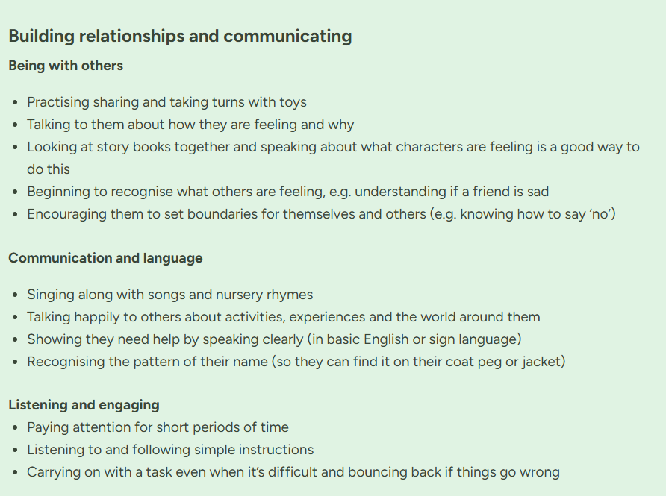

School readiness

Slide 9
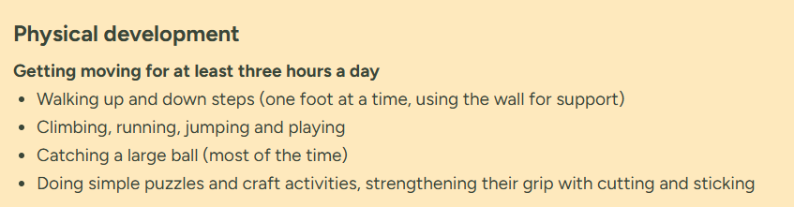
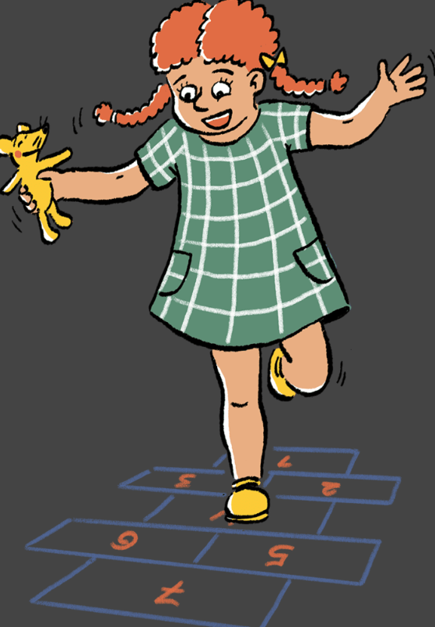
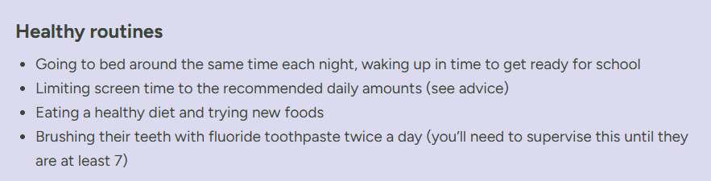
School readiness
https://startingreception.co.uk/

Slide 10
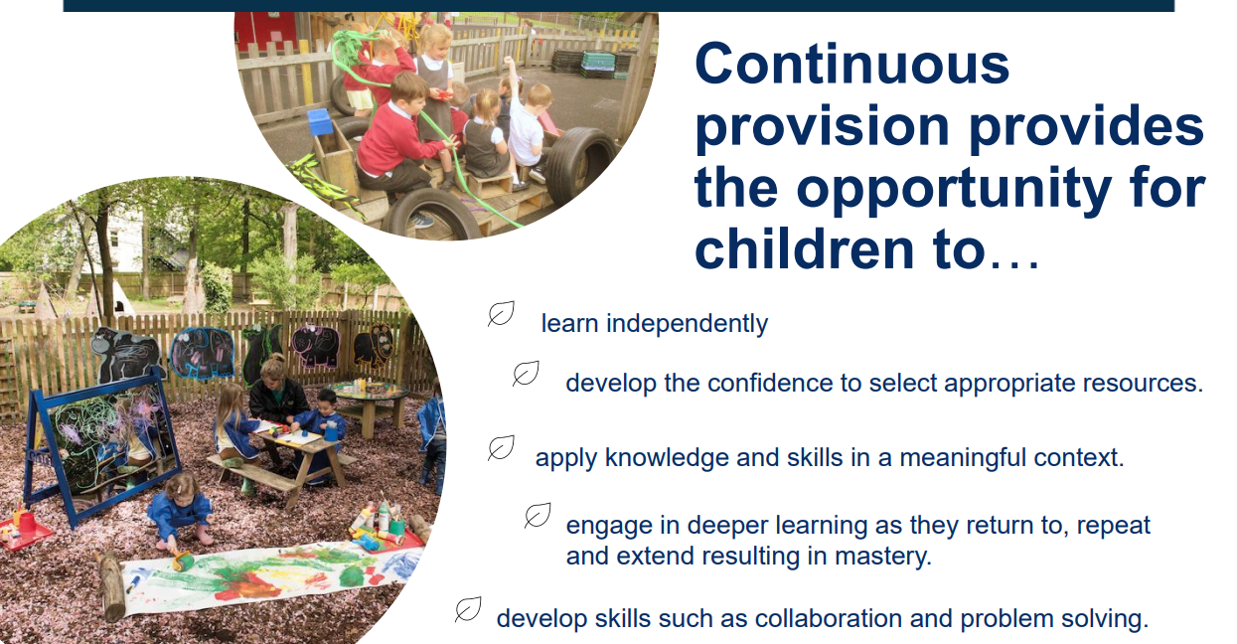
Year R/1 mixed- our vision
Notes:
Stretch and challenge- through questioning, use of resources, scaffolded tasks, teaching others
Support for children- interventions, questioning, breaking up skills, modelling

Slide 11
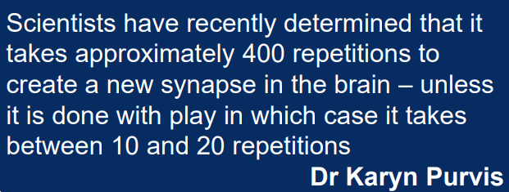
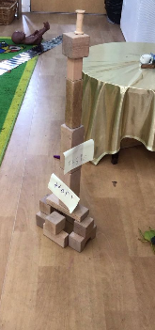
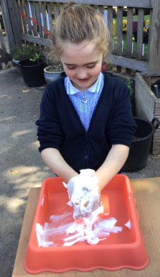
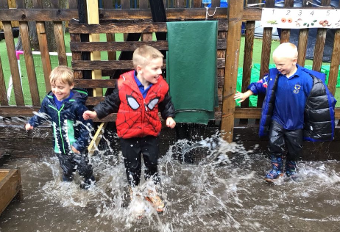
Year R/1 mixed- our vision

Slide 12

Year R/1 mixed- our learning
Separate
Phonics, reading – (depending on need)
Maths
Mixed
Wider curriculum
Inside/outside – COOL time (choose our own learning)
Lunch times and break times
Notes:
Reading and Phonics
We continue to use little wandle to support our reading and phonics
We will learn more complex sounds made up of two or more graphemes, this will continue through year 1.
We will also continue to learn tricky words.
Children will continue to bring home a book once a week.
Our aim is to have children who find pleasure in reading, read confidently and read for meaning as well.
We NEED your support. Please read daily at home.
Maths
We will continue to build on the mathematical knowledge gained in Year R.
Maths will continue to be practical in nature and children will be encouraged to use the classroom environment, inside and out to support their maths.
They will use a range of equipment to help them with their maths, some they are already confident with and new resources as well.
Over the course of the year they will be working with numbers up to 100.
We use an online maths program called numbots to support mental math, details will be sent out next term.

Slide 13
Phonics
Little Wandle
There will be a further information meeting for phonics in the autumn term.
This link takes you to a parents information page on Little Wandle’s website - https://www.littlewandle.org.uk/resources/for-parents/
Notes:
Reading and Phonics
We continue to use little wandle to support our reading and phonics
We will learn more complex sounds made up of two or more graphemes, this will continue through year 1.
We will also continue to learn tricky words.
Children will continue to bring home a book once a week.
Our aim is to have children who find pleasure in reading, read confidently and read for meaning as well.
We NEED your support. Please read daily at home.
Maths
We will continue to build on the mathematical knowledge gained in Year R.
Maths will continue to be practical in nature and children will be encouraged to use the classroom environment, inside and out to support their maths.
They will use a range of equipment to help them with their maths, some they are already confident with and new resources as well.
Over the course of the year they will be working with numbers up to 100.
We use an online maths program called numbots to support mental math, details will be sent out next term.

Slide 14
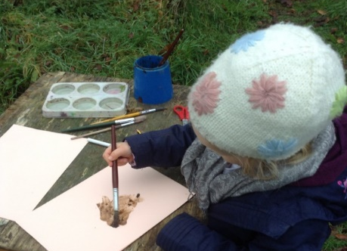
A day in class
8:40-3:30pm
Each day we will work hard on building relationships as this helps creates an environment where learning can happen.
Daily we are striving to encourage a love for learning (thrill), ensure children have motivation and resilience (will), and they develop specific capabilities (skill)
We do this by
Continuous Provision (COOL time) and adding enhancements in to the environment to take learning further
High quality questioning
Following children’s interests
Adult directed tasks – maths activities and counting practice, shared writing, games
Story time – rich vocabulary

Slide 15


Home - School link
How we will communicate with parents
Letters
PE kit reminders
Library/reading books with reading recorded in a journal – We expect reading to be something completed daily at home as we know the impact this has.
Numbots – all children will have an account
Notes:
Equipment
School uniform MUST be named.
PE kit MUST be named and needs to remain in school. We will send it home each half term. Please send it in in a named drawstring bag.
A named water bottle.
A named school book bag, please no backpacks is possible as they take up too much space.
Reading diaries and reading books need to be in school each day.

Slide 16
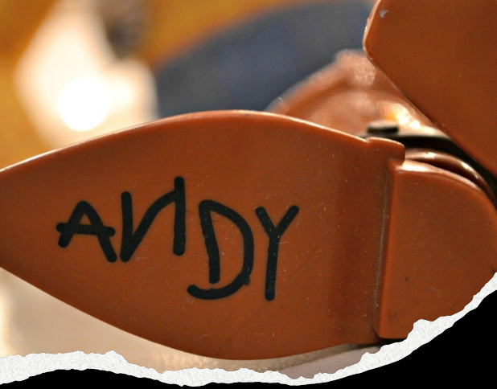


Remember
Notes:
Reading and Phonics
We continue to use little wandle to support our reading and phonics
We will learn more complex sounds made up of two or more graphemes, this will continue through year 1.
We will also continue to learn tricky words.
Children will continue to bring home a book once a week.
Our aim is to have children who find pleasure in reading, read confidently and read for meaning as well.
We NEED your support. Please read daily at home.
Maths
We will continue to build on the mathematical knowledge gained in Year R.
Maths will continue to be practical in nature and children will be encouraged to use the classroom environment, inside and out to support their maths.
They will use a range of equipment to help them with their maths, some they are already confident with and new resources as well.
Over the course of the year they will be working with numbers up to 100.
We use an online maths program called numbots to support mental math, details will be sent out next term.

Slide 17
Thank you for coming!

